Slide 1
A core Course on Modeling
Introduction to Modeling
0LAB0 0LBB0 0LCB0 0LDB0
c.w.a.m.v.overveld@tue.nl
v.a.j.borghuis@tue.nl
S.27

Slide 2
Conclude phase: interpret result
Reflection: interpret result
define
formulate
purpose
Right problem?
(problem validation)
conceptualize
identify
entities
choose
relations
Right concepts?
(concepts validation)
formalize
obtain
values
formalize
relations
Right model?
(model verification)
execute
operate
model
obtain
result
Right outcome?
(outcome verification)
Right answer?
(answer verification)
conclude
present
result
interpret
result
Notes:
2

Slide 3
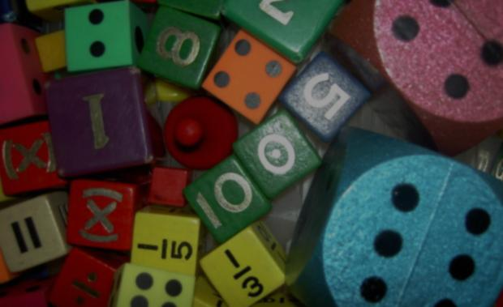
Dealing with uncertainty
Validation
Verification
Accuracy
Precision
involve dealing with
uncertainty,
represented as
a distribution.
This gives the probability (density)
of a particular but uncertain outcome
with some average and some spreading.
http://cdn.morguefile.com/imageData/public/files/j/jdurham/preview/fldr_2008_11_16/file000198601977.jpg
Notes:
3

Slide 4
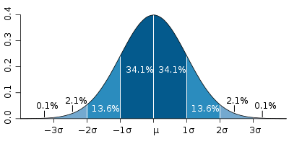
Distributions can be continuous (measuring)
Dealing with uncertainty
Validation
Verification
Accuracy
Precision
involve dealing with
uncertainty,
represented as
a distribution.
This gives the probability (density)
of a particular but uncertain outcome
with some average and some spreading.
Gaussian (normal) distribution: the sum of sufficiently many uncorrelated numbers
with average μ and spreading σ has a normal distribution.
E.g.: de weight distribution of 18-year old Americans.
Notes:
4

Slide 5
Distributions can be continuous (measuring) or discrete (counting, e.g. dice)
Dealing with uncertainty
Validation
Verification
Accuracy
Precision
involve dealing with
uncertainty,
represented as
a distribution.
This gives the probability (density)
of a particular but uncertain outcome
with some average and some spreading.
Uniform distribution:
all outcomes in an interval between μ-σ and μ+σ have equal probability.
Notes:
5

Slide 6
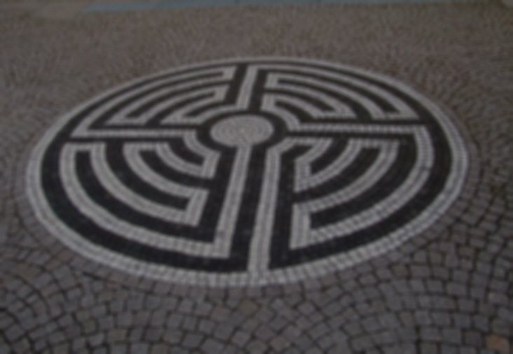
Distributions can be continuous (measuring) or discrete (counting, e.g. dice)
Dealing with uncertainty
Validation
Verification
Accuracy
Precision
involve dealing with
uncertainty,
represented as
a distribution.
This gives the probability (density)
of a particular but uncertain outcome
with some average and some spreading.
Uniform distribution:
all outcomes in an interval between μ-σ and μ+σ have equal probability.
QUIZ
What are μ and σ for a die?
Notes:
6

Slide 7
Distributions can be continuous (measuring) or discrete (counting, e.g. dice)
Dealing with uncertainty
Validation
Verification
Accuracy
Precision
involve dealing with
uncertainty,
represented as
a distribution.
This gives the probability (density)
of a particular but uncertain outcome
with some average and some spreading.
Uniform distribution:
all outcomes in an interval between μ-σ and μ+σ have equal probability.
E.g., die: μ=3.5, σ=2.5.
Notes:
7

Slide 8
Dealing with uncertainty: purpose
Example 1.
model used for decision making (e.g., diagnosis; classification ‘good’ or ‘bad’.)
medium confidence
low confidence
high confidence
http://www.clipartlord.com/wp-content/uploads/2013/04/stethoscope2.png
Confidence for diagnosis support. Compare model outcome against threshold. Confidence is lower if areas left and right from treshold are less different.
Validation: is the treshhold at the right place? Does checking with this treshhold mean anything w.r.t. the purpose?
Verification (for glass box): do we calculate the distribution correctly?
Accuracy: are we sure there is no bias?
Precision: can we obtain narrower distributions?
Notes:
8

Slide 9
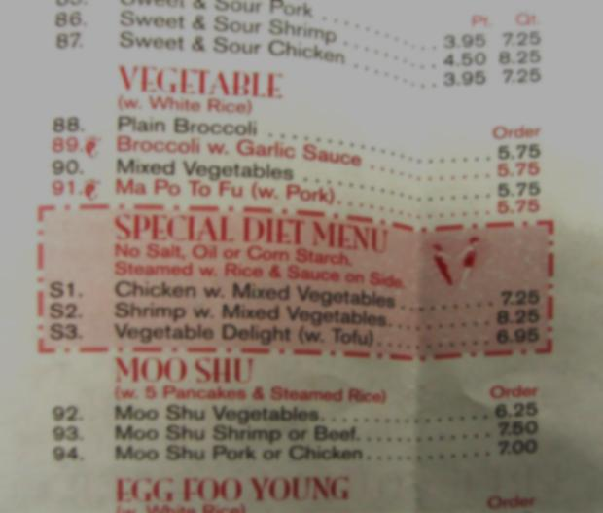
Dealing with uncertainty: purpose
Example 2.
model used in design: computed uncertainty intervals should be small enough to assess if A or B is better.
A
A
A
B
A
A
http://www.morguefile.com/archive/display/76905
medium confidence
low confidence
high confidence
Confidence for design decision support: compare one model outcome against a second model outcome.
Confidence is lower if the areas of two distributions have larger overlap.
Validation: do we compare the right properties?
Verification (for glass box): do we calculate the distribution correctly?
Accuracy: are we sure there is no bias?
Precision: can we obtain narrower distributions?
Notes:
9

Slide 10
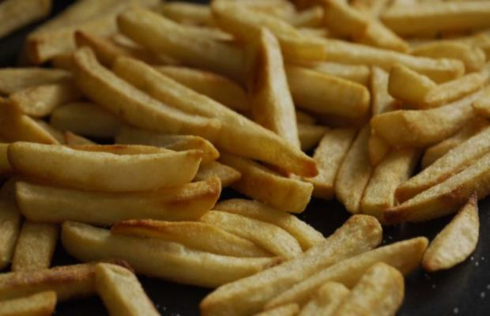
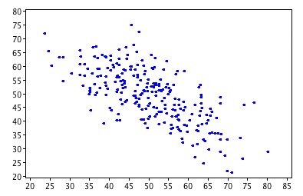
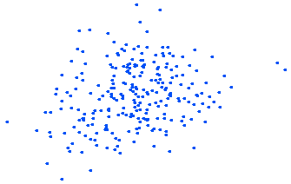
Confidence for black box models
72
71
70
http://www.morguefile.com/archive/display/773187
69
age (fictituous data)
68
67
66
5
10
15
20
25
30
35
40
45
50
55
60
65
70
consumed kg fries / year
Notes:
10

Slide 11
Confidence for black box models
72
71
70
http://commons.wikimedia.org/wiki/File:Scatterplot_r%3D-.69.png
http://www.morguefile.com/archive/display/773187
69
age (fictituous data)
68
67
66
5
10
15
20
25
30
35
40
45
50
55
60
65
70
consumed kg fries / year
Notes:
11

Slide 12
Confidence for black box models
72
QUIZ
What is the slope of the orange line in minutes/frie?
What does this slope mean?
71
70
http://commons.wikimedia.org/wiki/File:Scatterplot_r%3D-.69.png
http://www.morguefile.com/archive/display/773187
69
age (fictituous data)
68
67
66
5
10
15
20
25
30
35
40
45
50
55
60
65
70
consumed kg fries / year
Notes:
12

Slide 13
Confidence for black box models
72
on average,
people loose 2 years on 30 kg fries
→
you loose ... minutes of your life per frie
Do you believe that?
71
70
http://commons.wikimedia.org/wiki/File:Scatterplot_r%3D-.69.png
http://www.morguefile.com/archive/display/773187
69
age (fictituous data)
68
67
66
5
10
15
20
25
30
35
40
45
50
55
60
65
70
consumed kg fries / year
Notes:
13

